Slide 1
Welcome To York Code Dojo
David Betteridge @da_betteridge
Yorkdevelopers.org
@yorkdevelopers
@yorkcodedojo
Notes:
How many languages do you know?

Slide 2
Agenda
Quick Introduction
Explain the problem
Work in pairs till 8.45pm
Opportunity to show off solutions
Pub about 9pm

Slide 3
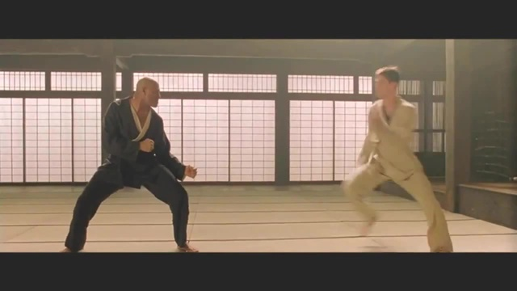
Code Dojo
Notes:
Aim for tonight isn’t to get a job, but to learn something news.
Who has been to a code dojo before?
What is the point?
It’s a place to practice coding safely. By that we mean it doesn’t matter if you haven’t solved the problem by the end of the evening. No one will judge you on it. It’s a place to practice, learn and try out new things.
For example you could use a language you have never used before, partner with someone new, try a different approach to solving the problem. You could add your own constraints; like my functions won’t have more than three lines; or I’m not going to use any IF statements.
(It’s also meant to be fun) It’s driving a car to work every day, you might cover a lot of miles, but if you are doing the same journey then does your driving ability really improve?
It’s driving a car to work every day, you might cover a lot of miles, but if you are doing the same journey then does your driving ability really improve?

Slide 4
“An esoteric programming language (ess-oh-terr-ick), or esolang, is a computer programming language designed to experiment with weird ideas, to be hard to program in, or as a joke, rather than for practical use. “

Slide 5
INTERCAL
PLEASE ,1 <- #2
DO .1 <- #2
DO ,1 SUB .1 <- #1
DO ,1 SUB #1 <- ,1 SUB #2
PLEASE ;1 <- #2 BY #2
DO ;1 SUB #1 #2 <- ,1 SUB ,1 SUB .1
DO READ OUT ;1SUB#1.1
DO GIVE UP
Notes:
First language created in 1972
Designed to be completely different from all other languages of it’s time
PLEASE 1/3 to 1/5
Both the language and documentation were written to make no sense!

Slide 6
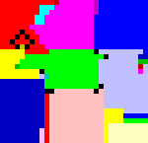
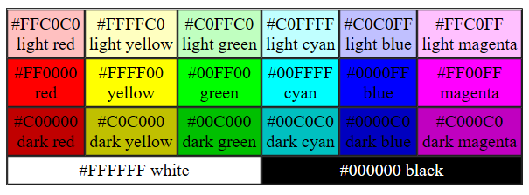
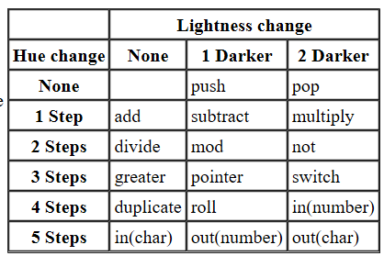
PIET
Notes:
Programs look like abstract paintings. It uses 20 colors, of which 18 are related cyclically through a lightness cycle and a hue cycle. A single stack is used for data storage, together with some unusual operations.

Slide 7
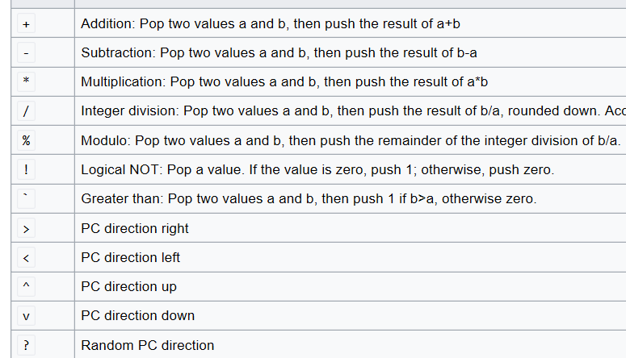
Befunge
64+"!dlroW ,olleH">:#,_@
Notes:
Program is as hard to compile as possible
On a 2D grid
Leeds Code Dojo
And there are many many more!

Slide 8
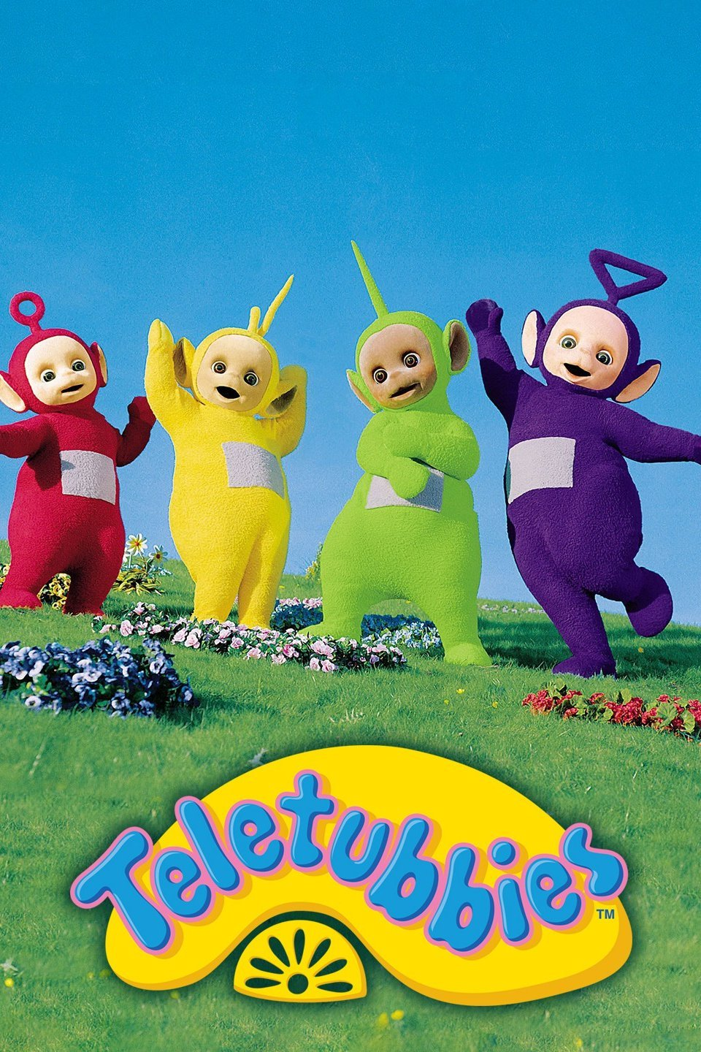
Notes:
4 variables called Po, Laa Laa, Tinky Winky and Dipsy
Po is Green (assign a constant)
Ask Po (print variable)
Po speaks to Laa Laa (assign a variable to another variable)
Ask Laa Laa
Po yells to Tinky Winky (but in uppercase - whisper for lowercase )
Ask Tinky Winky
Tell Dipsy your address (user input)
Ask Dipsy

Slide 9
Tonight
Invent your own (design and/or code)
Implement and extend my Teletubbies language
Use an existing language
Notes:
Keep parsing easy

Slide 10
Resources
https://esolangs.org
https://github.com/YorkCodeDojo/EsotericLanguages
WIFI – YSJ Guest
sunshinelayout26

Slide 11
York Developers include…
Games Developers (3rd Thursday of the month)
Code and Coffee (Monday and Wednesday mornings)
Agile York (3rd Wednesday of the month)
Dot Net York (1st Tuesday of the month)
And more

